Slide 1
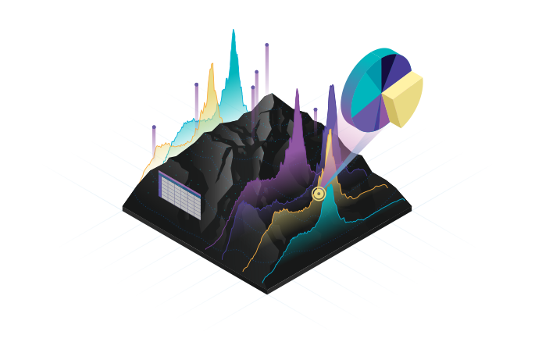
Unit 2
Data Management & Processing SYSTEMS
CHAPTER I
TYBSC IT SEM VI
PROF. ARTI GAVAS
ANNA LEELA COLLEGE OF COMMERCE AND ECONOMICS,
SHOBHA JAYARAM SHETTY COLLGE FOR BMS, KURLA

Slide 2
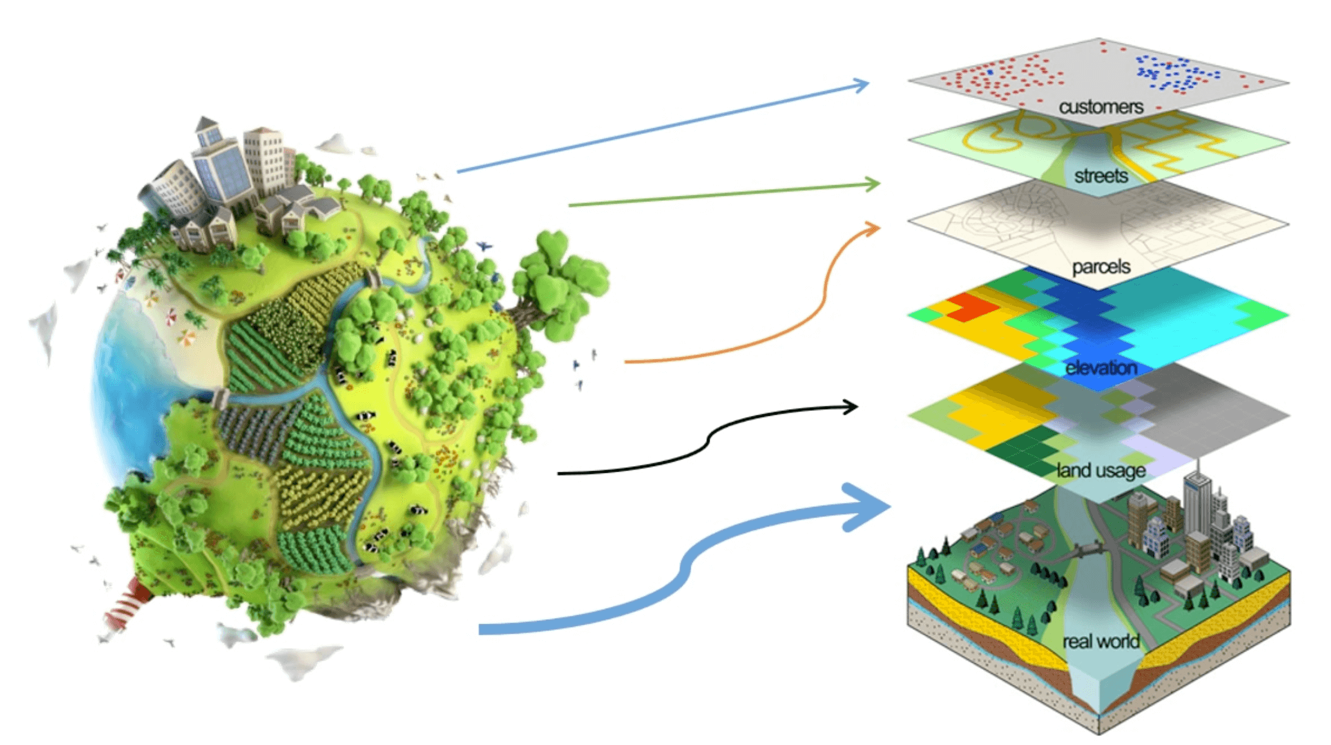
Data processing system
Refers to hardware and software components which are able to process, store and transfer data
OR
The components of systems that facilitate the management and processing of geo information.

Slide 3
Hardware and software trends
Hand-held computers
field surveyors with powerful tools, complete with GPS capabilities for instantaneous geo-referencing
To support these hardware trends, software providers continue to produce application programs and operating systems
significantly more memory
Computer networks allowing fast and reliable exchange of (spatial) data
Mobile phones with data connection
Bluetooth , wireless LAN , copper and fiber optic networks, dial-up

Slide 4
Geographic information systems
GIS provides a range of capabilities to handle geo referenced data, including:
  Data capture and preparation,
  Data management (storage and maintenance),
  Data manipulation and analysis, and
  Data presentation.
Earlier : analogue data sources were used, processing was done manually, and paper maps were produced
Now : increased use of computers, digital information, software technology = geographic information systems

Slide 5
Data requirements
Data sources, both spatial and non-spatial, from different national institutes, like national mapping agencies, geological, soil, and forest survey institutes, and national census bureaus.
The data sources obtained may be from different time periods, and the spatial data may be in different scales or projections.
With the help of a GIS, the spatial data can be stored in digital form in world coordinates.
This makes scale transformations unnecessary, and the conversion between map projections can be done easily with the software.
With the spatial data thus prepared, spatial analysis functions of the GIS can then be applied to perform the planning tasks.

Slide 6
GIS software
The main characteristics : analytical functions that provide means for deriving new geo information from existing spatial and attribute data
any package that provides support for only rasters or only objects, is not a complete GIS
Well-known, full-fledged GIS packages include ILWIS, Intergraph’s GeoMedia, ESRI’s ArcGIS, and MapInfo from Map- packages Info Corp., QGIS 2.2, 2.8 & 3.14.

Slide 7
Software development in GIS
Shared Geodata
Embedded GIS
Desktop GIS
CAD based GIS
Internet GIS
Open GIS
Professional GIS

Slide 8
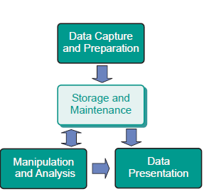
GIS architecture and functionality
Geographic information system in the wider sense consists of software, data, people, and an organization in which it is used.
Functional components of GIS:

Slide 9
Spatial Data Infrastructure (SDI)
Framework for sharing and integration of spatial data
It depends on data, services, policies and application used
Framework describes data, metadata, users and tools
Standards for capturing, sharing and presentation have been developed by International Organization for Standardisation (ISO) and the Open Geospatial Consortium (OGC)
Geo-web-services: software programs that act as an intermediate between geographic data(bases) and the users of the web

Slide 10
Basic software components of SDI
Software client:
  To display, query & analyse spatial data ( web or desktop gis)
Catalogue service:
  discovering, browsing & querying of metadata or spatial data (datasets)
Spatial data service:
  allows delivery of data via internet
Processing service:
  data, projection and scale transformation
Spatial data repository:
  to store data
GIS software:
  to create & update data

Slide 11
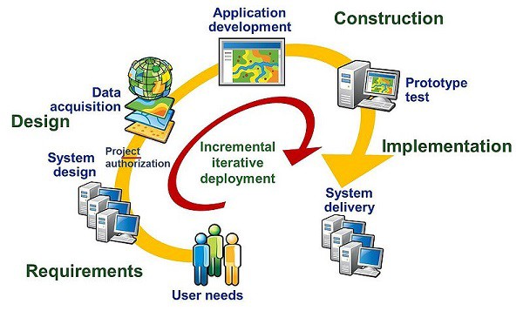
Stages of spatial data handling
Spatial data capture and preparation
Spatial data storage and maintenance
Spatial query and analysis
Spatial data presentation

Slide 12
Spatial data capture and preparation
Data can be collected through :
  First hand observation → primary source
  Published data → secondary source
Capturing can be done through
  scanning,
  photogrammetric,
  remote sensing,
  digitization of analog map,
  field survey etc
From raw base data spatial data sets are derived
Data conversion can be required sometimes.

Slide 13
Data Acquisition
Data input methods & devices
Existing graphics or Images
Manual digitizing
coordinate entry via keyboard, digitizing table, stereoplotter
Automatic / Semi automatic digitizing
Scanner, line-following software
Real time data
GPS, Surveying
Existing digital data
Topographic maps, road network, Census data

Slide 14
Spatial data storage and maintenance
Spatial data is organized in layers
Representation of the real world has to be designed to reflect phenomena and their relationships as naturally as possible
Vector data types describe an object through its boundary, thus dividing the space into parts that are occupied by the respective objects.
The raster approach subdivides space into cells, mostly as a tessellation. These cells are called either cells or pixels in 2D, and voxels in 3D.

Slide 15
Raster storage
It is stored in a file as a long list of values, preceded by a small list of extra data (the so-called ‘file header’) that informs how to interpret the long list.
The order of the cell values in the list can be—but need not be—left-to-right, top-to-bottom
The header of the raster file will typically inform how many rows and columns the raster has, which encoding scheme is used, and what sort of values are stored for each cell.
Raster files can be quite big data sets. For computational reasons, it is wise to organize the long list of cell values in such a way that spatially nearby cells are also near to each other in the list.
This is why other encoding schemes have been devised.

Slide 16
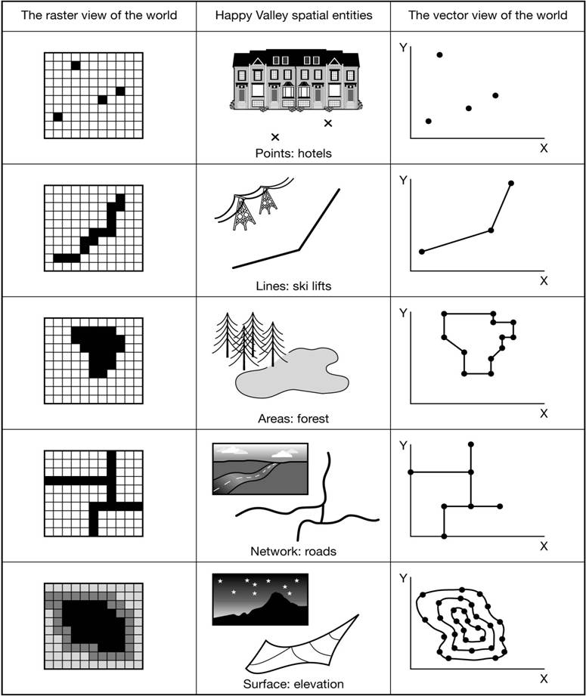
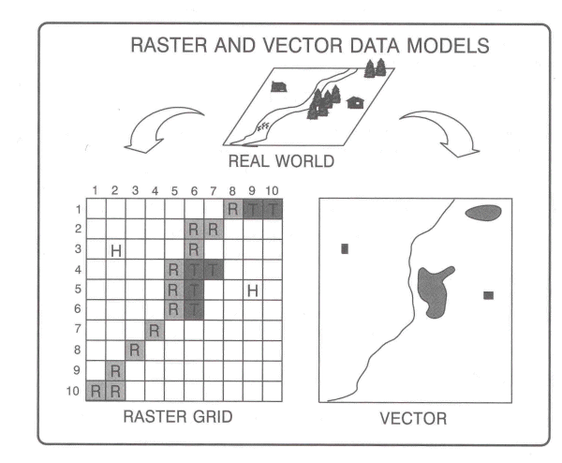
Vector storage
Boundary model for polygon

Slide 17
DBMS
GIS software packages provide support for both spatial and attribute data
GIS applications have been able to link to an external database to store attribute data
All major GIS packages provide facilities to link with a DBMS and exchange attribute data with it.
Spatial and attribute data are stored in separate structures, although they can now be stored directly in a spatial database.

Slide 18
Data maintenance
To keep the data set up-to-date and as supportive as possible to the user community
It deals with obtaining new data, and entering them into the system, possibly replacing outdated data. The purpose is to have an up-to-date stored data set available
Updation of spatial data is required because many aspects of the real world changes continuously.
Local change to the large spatial data set is more typically required.
They should leave other spatial data within the same layer intact and correct.

Slide 19
Spatial query and analysis
Spatial analysis: GIS operators that use spatial data to derive new geo information.
GIS supports spatial decisions.
Spatial decision support systems (SDSS): database, GIS software, models and a knowledge engine
GIS use the spatial and non-spatial attributes of the data in a spatial database to provide answers to user questions.
Analysis of spatial data can be defined as computing new information that provides new insight from the existing, stored spatial data.

Slide 20
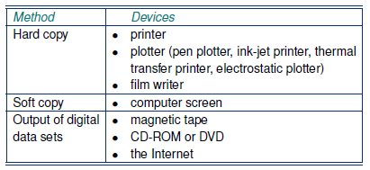
Spatial data presentation
The presentation of spatial data: in print or on-screen, in maps or in tabular displays, or as raw data
The presentation may either be an end-product, for example as a printed atlas, or an intermediate product, as in spatial data made available through the internet

Slide 21
DATABASE MANAGEMENT SYSTEM
Reasons for using a DBMS
  A DBMS supports the storage and manipulation of very large data sets.
  A DBMS can be instructed to guard over data correctness.
  A DBMS supports the concurrent use of the same data set by many users
  A DBMS provides a high-level, declarative query language
  A DBMS supports the use of the data model
  A DBMS includes data backup and recovery functions to ensure data availability at all times
  A DBMS allows the control of data redundancy.

Slide 22
ALTERNATIVES FOR DATA MANAGEMENT
When data set is small, relatively simple, just one user
  Use simple text files, text processor for ex. Personal address book
When data set is still small but numeric
  Use spreadsheet program

Slide 23
THE RELATIONAL DATA MODEL
The relational model represents the database as a collection of relations.
A relation is nothing but a table of values.
Every row in the table represents a collection of related data values.
These rows in the table denote a real-world entity or relationship.

Slide 24
Relational Model Concepts
Attribute: Each column in a Table. Attributes are the properties which define a relation. e.g., Student_Rollno, NAME,etc.
Tables – In the Relational model the, relations are saved in the table format. It is stored along with its entities. A table has two properties rows and columns. Rows represent records and columns represent attributes.
Tuple – It is nothing but a single row of a table, which contains a single record.
Relation Schema: A relation schema represents the name of the relation with its attributes.
Degree: The total number of attributes which in the relation is called the degree of the relation.
Cardinality: Total number of rows present in the Table.
Column: The column represents the set of values for a specific attribute.
Relation instance – Relation instance is a finite set of tuples in the RDBMS system. Relation instances never have duplicate tuples.
Relation key - Every row has one, two or multiple attributes, which is called relation key.
Attribute domain – Every attribute has some pre-defined value and scope which is known as attribute domain

Slide 25
Advantages of using Relational model
Simplicity: A relational data model is simpler than the hierarchical and network model.
Structural Independence: The relational database is only concerned with data and not with a structure. This can improve the performance of the model.
Easy to use: The relational model is easy as tables consisting of rows and columns is quite natural and simple to understand
Query capability: It makes possible for a high-level query language like SQL to avoid complex database navigation.
Data independence: The structure of a database can be changed without having to change any application.
Scalable: Regarding a number of records, or rows, and the number of fields, a database should be enlarged to enhance its usability.

Slide 26
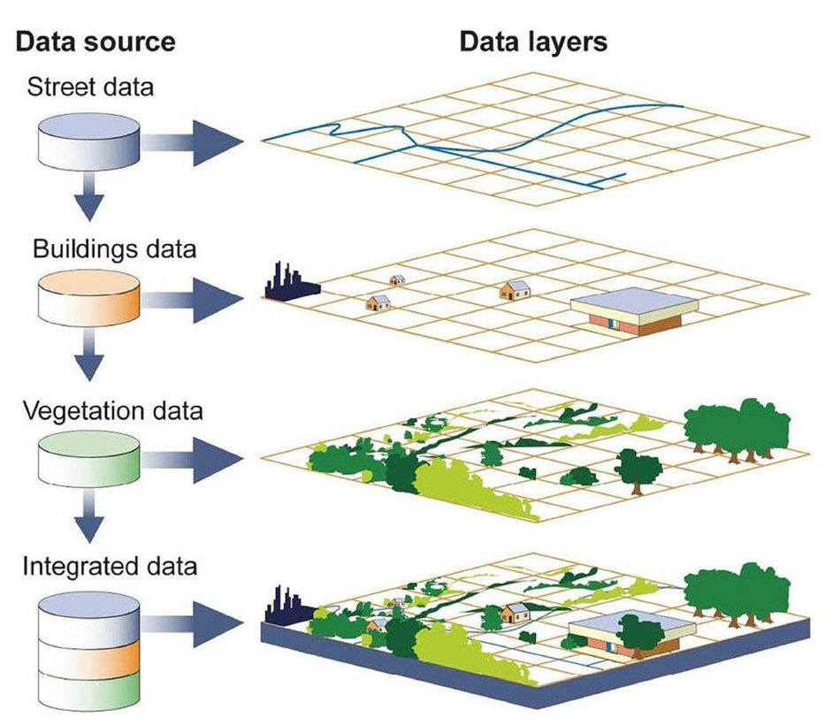
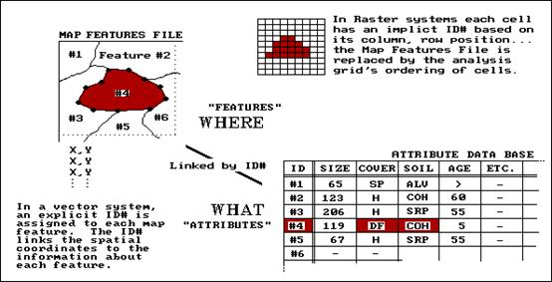
GIS AND SPATIAL DATABASE
Linking GIS and DBMS

Slide 27
SPATIAL DATABASE FUNCTIONALITY
A spatial database is a database that is enhanced to store and access spatial data or data that defines a geometric space.
These data are often associated with geographic locations and features, or constructed features like cities.
Data on spatial databases are stored as coordinates, points, lines, polygons and topology.
Some spatial databases handle more complex data like three-dimensional objects, topological coverage and linear networks.

Slide 28
FEATURES OF SPATIAL DATABASE
Spatial Measurements length of lines, area of polygon, the distance between geometries etc. can be measured easily in spatial database.
Spatial Functions Modify existing features to create new ones, for example, intersecting features, etc.
Spatial Predicates: Allows true/false queries about spatial relationships between geometries.
Geometry Constructors Helps in creating new geometrics by specifying the vertices (points or nodes) which define the shape.
Volume The size of spatial data are larger. It contains multidimensional data that require more storage space. Spatial database are more suited for multidimensional data.

Slide 29
Querying a spatial database
A spatial query is a special type of database query supported by geo-databases and spatial databases.
The queries differ from non-spatial SQL queries in several important ways. Two of the most important are that they allow for the use of geometry data types such as points, lines and polygons and that these queries consider the spatial relationship between these geometries.
Types of queries
  Distance(geometry, geometry) : number
  Equals(geometry, geometry) : boolean
  Disjoint(geometry, geometry) : boolean
  Intersects(geometry, geometry) : boolean
  Touches(geometry, geometry) : boolean
  Crosses(geometry, geometry) : boolean
  Overlaps(geometry, geometry) : boolean
  Contains(geometry, geometry) : boolean
  Length(geometry) : number
  Area(geometry) : number
  Centroid (geometry) : geometry

Slide 30
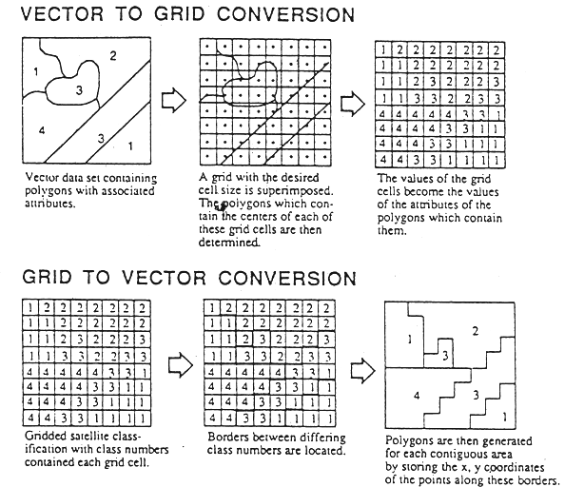
Vector to Raster - Raster to Vector Conversion
Rasterization refers to converting vectors into rasters. While vectorization transforms rasters in vectors.
Vector data are composed of vertices and paths. For example, the three types of vectors are points, polylines and polygons.

